Slide 1
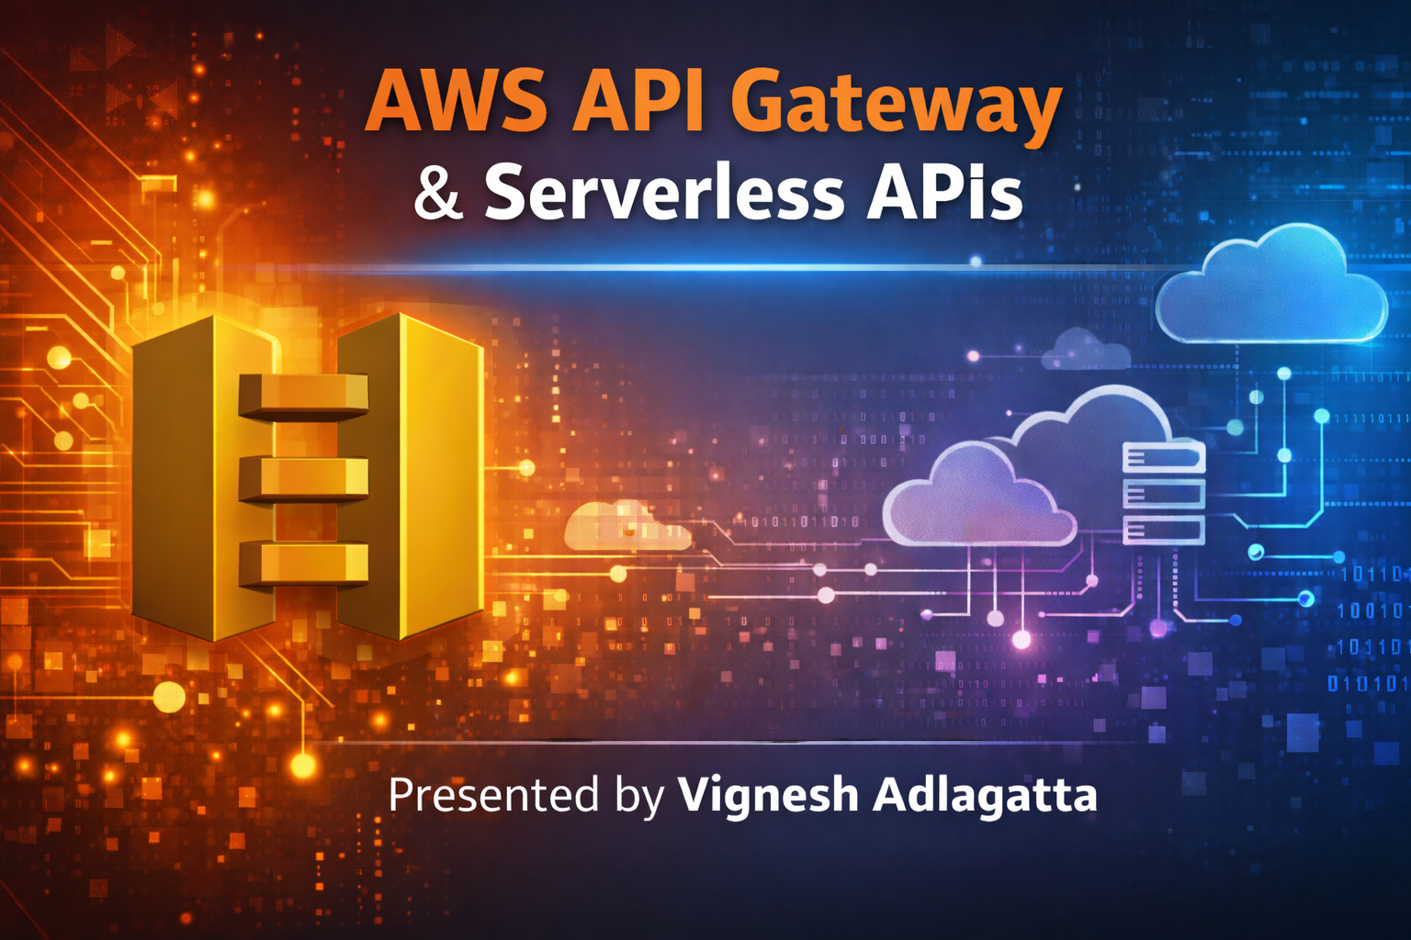

Slide 2
Module 1 — API Fundamentals
AWS API Gateway Complete Guide
From Basics to Real-Time Architecture
SPEAKER NOTES:

Slide 3
Agenda
1. Introduction to APIs
2. What is AWS API Gateway
6. Monitoring and Logging
3. Architecture and Request Flow
7. Real-world Examples
4. HTTP Methods
8. Best Practices
5. Security and Authentication
SPEAKER NOTES:

Slide 4

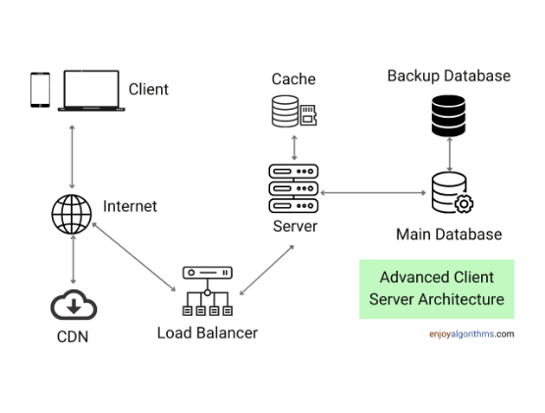
What is an API?
Application Programming Interface.
Allows two independent software systems to communicate and share data securely.
Example Flow: Client → API → Server → Database
Real-world Example: A mobile weather app retrieving the current forecast from a meteorological server.
SPEAKER NOTES:

Slide 5
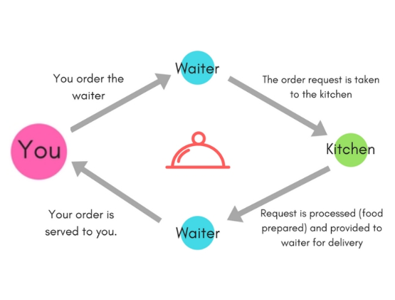
The Restaurant Analogy
Customer = Client: You, sitting at the table, requesting food.
Waiter = API: Takes your order, translates it for the kitchen, and brings the food back.
Kitchen = Backend Server: Prepares the requested food out of sight.
Food Returned = API Response: The final product delivered to you.
SPEAKER NOTES:

Slide 6
Module 2
AWS API Gateway Overview
SPEAKER NOTES:

Slide 7


What is AWS API Gateway?
A fully managed AWS service that makes it easy to create, publish, and maintain APIs.
Acts as the "front door" for applications to access backend data or functionality.
Capable of handling hundreds of thousands of concurrent API calls.
Fully Managed
No servers to patch. AWS handles traffic management, authorization, access control, and monitoring.
Used for: Mobile apps, Web apps, IoT devices, and Microservices architecture.
SPEAKER NOTES:

Slide 8


Why API Gateway is Needed?
Without API Gateway
With API Gateway
Clients connect directly to servers.
Single, unified entry point.
High security risks (exposed IPs).
Backend servers remain strictly private.
Servers overwhelmed by connection limits.
Offloads authentication and throttling.
Hard to manage, scale, and update APIs.
Easily route traffic to Lambdas, EC2, or S3.
SPEAKER NOTES:

Slide 9






Module 3: Types of API Gateway
REST API
HTTP API
WebSocket API
Full-featured API. Supports API Keys, usage plans, request validation, and complex mapping templates. Ideal for enterprise public APIs.
Lower cost and lower latency compared to REST. Optimized for serverless workloads and AWS Lambda integrations. Very fast setup.
Enables two-way, persistent, real-time communication. Best for chat applications, live dashboards, and multiplayer games.
SPEAKER NOTES:

Slide 10
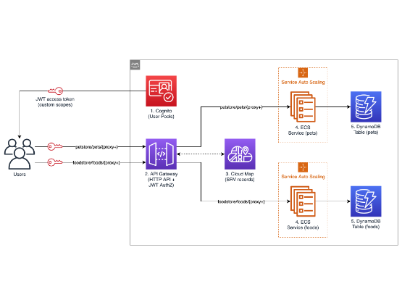
Module 4: AWS Architecture Diagram
Client: User device making an HTTP request.
API Gateway: Receives and validates the request.
Compute: Routes to AWS Lambda, EC2 instances, or an external HTTP backend.
Database: Backend compute interacts with DynamoDB or RDS.
SPEAKER NOTES:

Slide 11


Standard Request Flow
Client Request
Validation
Authorization
Integration
Response
Client sends HTTP request to endpoint.
Gateway checks payload formatting.
Identity verified via IAM or Cognito.
Request routed to backend (Lambda).
Backend data returned to the client.
SPEAKER NOTES:

Slide 12
Module 5
HTTP Methods (Verbs)
SPEAKER NOTES:

Slide 13


HTTP Method: GET
Purpose: Retrieve data from the server. It should never modify data.
Use Case: Fetching a user profile, loading a product catalog.
GET
Example Route: (List all users) (Get order #101)
Safe & Idempotent: Calling it multiple times yields the same result.
SPEAKER NOTES:

Slide 14


HTTP Method: POST
Purpose: Create new data or submit a payload to the server.
Use Case: Registering a new user account, placing a new shopping order.
POST
Example Route: (Create a user) (Submit an order)
Not Idempotent: Clicking submit twice might create two separate orders!
SPEAKER NOTES:

Slide 15

HTTP Method: PUT
Purpose: Update a complete resource. It replaces the entire target object.
Use Case: Updating a user's entire profile where all fields must be supplied.
PUT
Example Route:
Idempotent: Updating the exact same data 10 times leaves the system in the same state.
SPEAKER NOTES:

Slide 16

HTTP Method: PATCH
Purpose: Update partial data. It modifies only the specific fields provided.
Use Case: Changing just the password or updating only the shipping address.
PATCH
Example Route:
Efficiency: Saves bandwidth since you don't need to send the entire object payload.
SPEAKER NOTES:

Slide 17


HTTP Method: DELETE
Purpose: Remove or delete a specific resource from the server.
Use Case: Deleting an account, canceling an order, removing an item from a cart.
DELETE
Example Routes:
Security: Usually requires strict authentication and authorization checks.
SPEAKER NOTES:

Slide 18
HTTP Method: OPTIONS
Purpose: Used for CORS (Cross-Origin Resource Sharing) preflight requests.
OPTIONS
Browser Behavior: Browsers automatically send this to check which methods are allowed before sending a real request (like POST).
Response: Returns headers indicating allowed origins and allowed methods (GET, POST, etc.).
SPEAKER NOTES:

Slide 19


HEAD and ANY Methods
HEAD Method
ANY Method (AWS Specific)
Returns ONLY the headers, no body data.
A special wildcard method in API Gateway. Handles all HTTP methods with a single route (e.g., ANY /products).
Use Case: Checking if a resource exists, or checking file sizes before downloading large files.
How it works: All traffic routes to one Lambda. Lambda checks event.httpMethod to decide what to do.
SPEAKER NOTES:

Slide 20
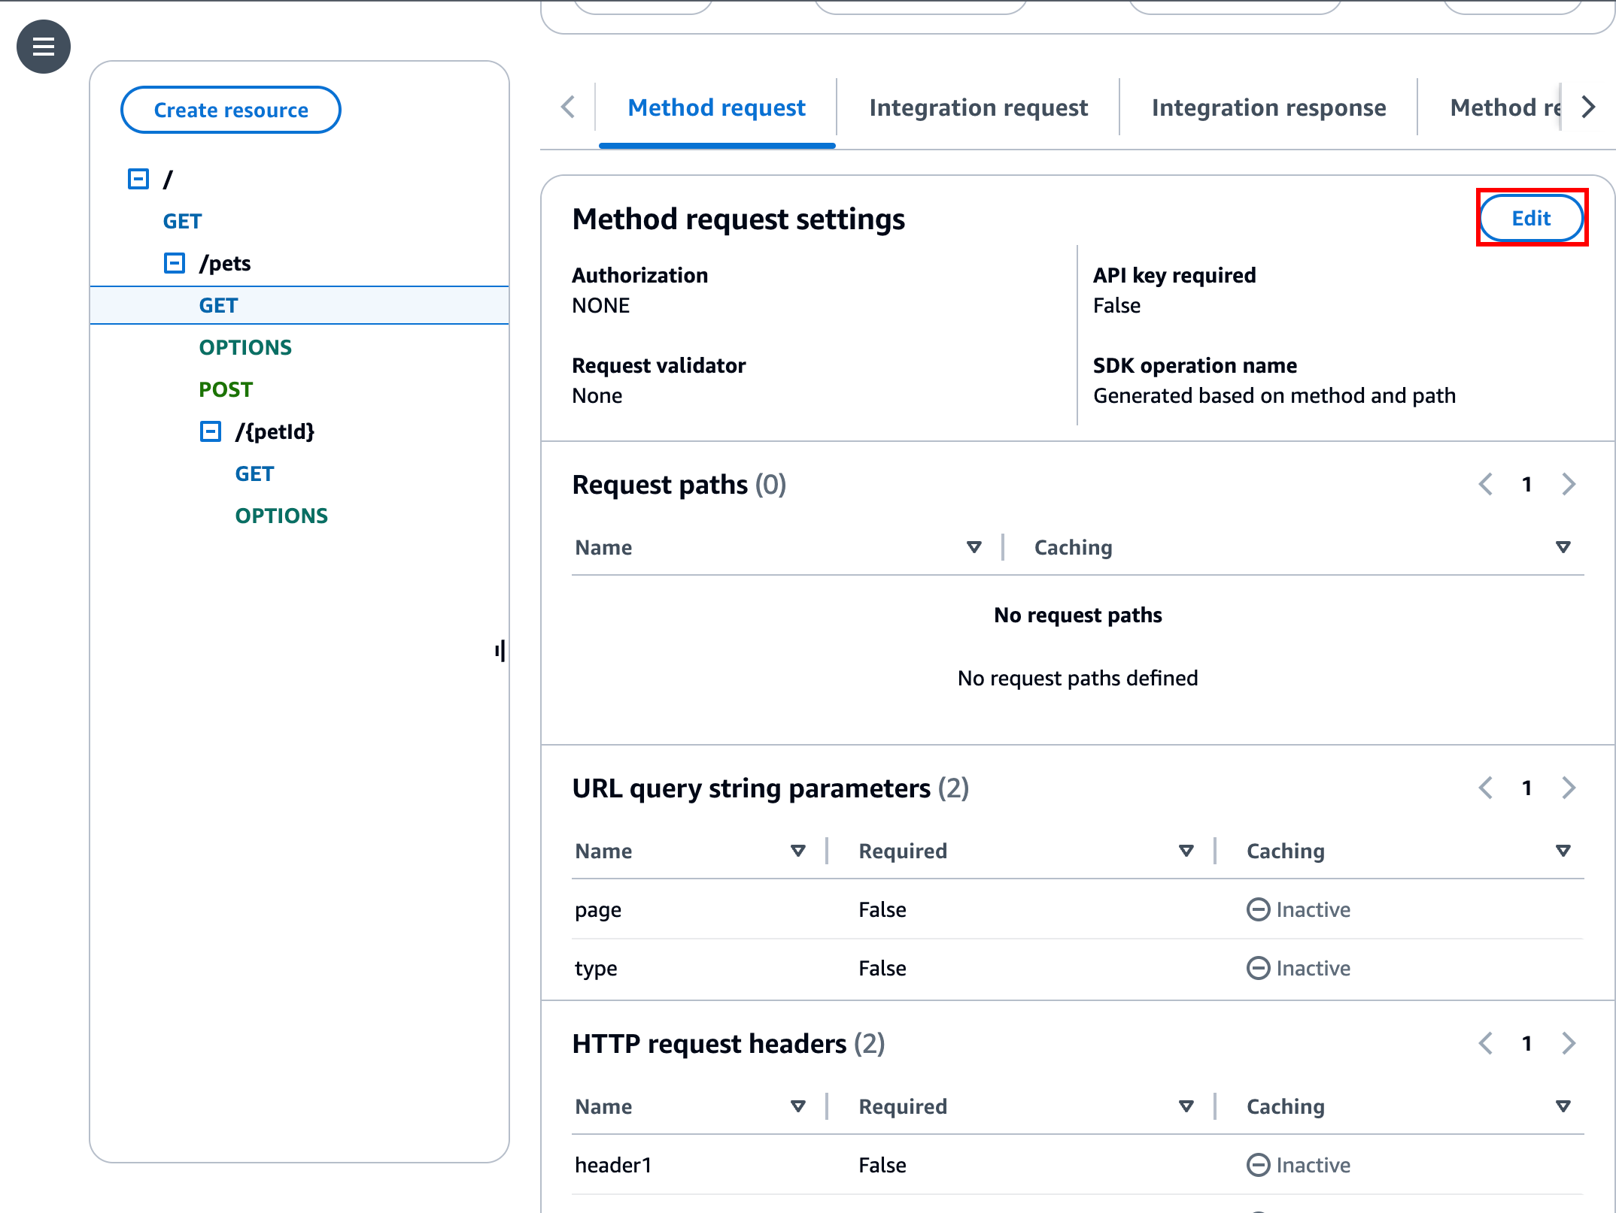

Module 6: Console Walkthrough
APIs: Dashboard listing all REST, HTTP, and WebSocket APIs.
Routes/Resources: Where you define your URL paths (e.g., `/users`).
Stages: Deployment environments like `dev`, `test`, `prod`.
API Keys & Usage Plans: For monetizing and throttling third parties.
SPEAKER NOTES:

Slide 21


Creating an API: The 4 Steps
1. Create API
2. Define Routes
3. Integration
4. Deploy Stage
Choose REST or HTTP protocol.
Create paths like /users and assign methods.
Link the route to Lambda or a backend.
Publish to an environment (e.g., Prod).
SPEAKER NOTES:

Slide 22


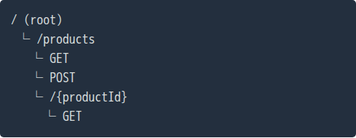
Routes and Resources
Resources represent the logical entities in your system.
They follow a tree structure. Example:
Resource Tree
/orders
/{orderId}
Each resource (route) supports multiple methods (GET, POST).
Path parameters like {orderId} allow dynamic routing.
SPEAKER NOTES:

Slide 23







Integration Types
Lambda Proxy
HTTP Backend
AWS Services
VPC Link
Passes the entire HTTP request directly to AWS Lambda and expects a formatted response back.
Acts as a reverse proxy, forwarding requests to an existing EC2 instance or external web server.
Directly integrates with other AWS services (e.g., directly putting a message into an SQS queue).
Securely routes traffic to private resources inside a VPC, bypassing the public internet.
SPEAKER NOTES:

Slide 24
Module 7
Security & Authentication
SPEAKER NOTES:

Slide 25




Authentication Methods
IAM Authentication
Cognito User Pools
Uses AWS IAM roles and Signature Version 4. Best for internal AWS-to-AWS service communication.
Native integration. Verifies JWT tokens from Amazon Cognito automatically. Great for mobile/web apps.
Lambda Authorizers
JWT Authentication
Custom Lambda function that evaluates a bearer token (like Auth0 or Okta) and returns an IAM policy.
Built-in JWT validation (OpenID Connect), native to HTTP APIs. Extremely fast and lightweight.
SPEAKER NOTES:

Slide 26


Authorization (Access Control)
Authentication is verifying who you are. Authorization is verifying what you can do.
Control access to specific API routes based on user roles or scopes.
OAuth Scopes
Example: Standard users can GET /orders, but only Admin users can DELETE /orders.
API Gateway can validate scopes present in JWT tokens automatically, blocking unauthorized requests before they hit your backend.
Lambda Authorizers return an IAM Policy granting `Allow` or `Deny` dynamically.
SPEAKER NOTES:

Slide 27

API Keys & Usage Plans
API Keys: Alphanumeric strings used to track and identify third-party developers calling your API.
Should not be used for user authentication!
Usage Plans: Define request limits and quotas associated with API keys.
Monetization
Usage plans allow you to productize your APIs. You can sell access tiers and automatically block developers who exceed their quota.
Example:
Bronze Plan: 100 requests/day
Gold Plan: Unlimited requests
SPEAKER NOTES:

Slide 28
Module 8
Traffic Management
SPEAKER NOTES:

Slide 29
Throttling & Rate Limiting
Throttling
Burst Limiting
Limits the steady-state number of requests per second (RPS). Example: Set limit to 100 req/sec. Prevents backend databases from being overwhelmed during traffic spikes.
Handles sudden spikes using the Token Bucket algorithm. Response: When limits are exceeded, Gateway immediately returns a 429 Too Many Requests error.
SPEAKER NOTES:

Slide 30

Module 9: Performance (API Caching)
API Caching: Stores frequently used backend responses in memory.
Greatly reduces latency (faster APIs for clients).
Reduces the number of calls made to your backend endpoints, saving costs and load.
How it Works
First request hits the backend. Gateway caches the response. Next 10,000 requests are served directly from Gateway memory instantly.
TTL (Time-To-Live): Dictates how long data stays cached (default is 300 seconds).
SPEAKER NOTES:

Slide 31
Module 10
Monitoring & Observability
SPEAKER NOTES:

Slide 32
CloudWatch Metrics & Logs
CloudWatch Metrics
CloudWatch Logs
Aggregated data points monitored in real-time. Key Metrics: • Latency (Integration vs Gateway) • Count (Total Requests) • 4xx / 5xx Errors
Detailed textual records of API executions. Execution Logs: Details request/response payloads, auth failures, and routing. Access Logs: Who accessed what, when, and from which IP.
SPEAKER NOTES:

Slide 33

AWS X-Ray (Tracing)
Distributed Tracing: Tracks a request visually as it travels through multiple AWS services.
Identifies exactly where performance bottlenecks are occurring.
Find the Fault
Example: Generates a service map showing: API Gateway (50ms) → Lambda (200ms) → DynamoDB (1.5s)
Instead of guessing why an API is slow, X-Ray gives you a visual timeline, instantly highlighting if the database or the compute layer is the culprit.
SPEAKER NOTES:

Slide 34
Module 11
Real-World Architecture Example
SPEAKER NOTES:

Slide 35
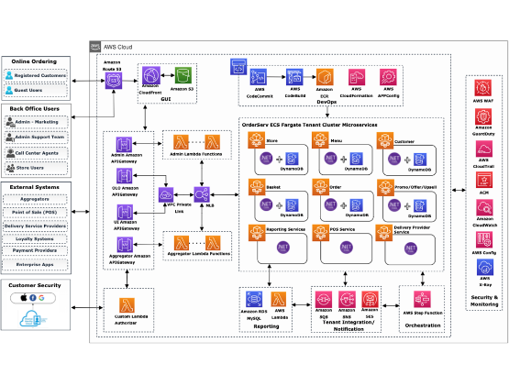
Food Ordering Architecture
Customer App: Mobile user interface.
API Gateway: Receives traffic, validates auth via Cognito, manages throttling.
Lambda: Processes business logic.
DynamoDB: Stores order history.
External API: Payment processing.
SPEAKER NOTES:

Slide 36
Request Flow Example
Press "Order"
POST Request
Validation
Processing
Storage
User submits order on mobile app.
POST /order sent to API Gateway.
Token checked, rate limit verified.
Lambda processes payment logic.
Order safely stored in DynamoDB.
SPEAKER NOTES:

Slide 37
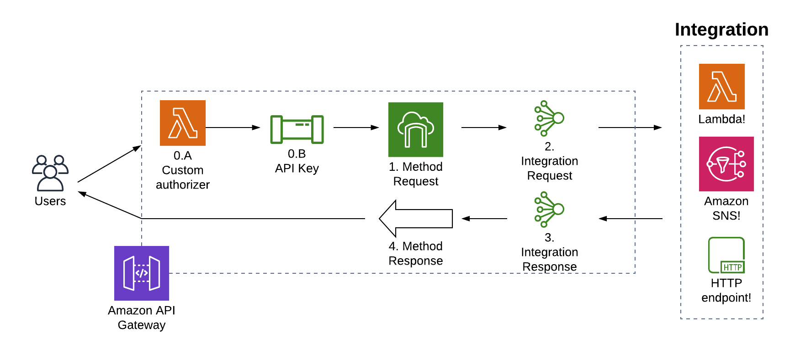
API Gateway Architecture Flow

Slide 38

Module 12: Best Practices
Use Versioning: Always version APIs in the URL (e.g., /v1/orders, /v2/orders).
Enable Caching: For heavy read operations to improve latency.
Architect Tip
Enable Throttling: Protect backend resources from DDoS or runaway scripts.
Never break existing clients. If you need to make a drastic change to your payload structure, deploy a V2 API alongside V1.
Validate Input: Use Gateway request validators to reject bad payloads before invoking Lambda.
SPEAKER NOTES:

Slide 39



Cost Model Structure
REST API
HTTP API
Free Tier
~$3.50 per million requests
~$1.00 per million requests
1 Million free requests
Plus data transfer costs. Highly featured.
Cheaper and faster. Less features.
Per month for the first 12 months.
SPEAKER NOTES:

Slide 40
Common Interview Questions
What is the maximum timeout of API Gateway? 29 seconds (Hard limit, cannot be increased).
Difference between REST and HTTP APIs? REST has full features (WAF, caching). HTTP is cheaper/faster.
What is throttling? Limiting request rates to protect backend stability.
What is the ANY method? A wildcard route that captures all HTTP verbs (GET, POST, etc.).
SPEAKER NOTES:

Slide 41






Summary
The Front Door
Heavy Lifting
Serverless Pair
API Gateway is the single, secure entry point for all modern AWS applications.
It handles routing, robust security, request throttling, and infinite scaling automatically.
Works perfectly in tandem with AWS Lambda to create zero-maintenance backends.
SPEAKER NOTES:

Slide 42

Thank You
Questions and Discussion?
Key Takeaways:
Secure APIs with Authorizers. Monitor performance with X-Ray. Design scalable architectures.
SPEAKER NOTES:

Slide 43




Image Sources
https://miro.medium.com/v2/1*SBH_Y5t32ixv8C_F1MVYzA.png
Source: medium.com
https://i.sstatic.net/ChtPo.png
Source: softwareengineering.stackexchange.com
https://d2908q01vomqb2.cloudfront.net/fc074d501302eb2b93e2554793fcaf50b3bf7291/2020/08/21/Figure-1-Architecture-Diagram.png
Source: aws.amazon.com
https://d2908q01vomqb2.cloudfront.net/77de68daecd823babbb58edb1c8e14d7106e83bb/2022/10/24/Cognizant-OrderServ-2.0-2.png
Source: aws.amazon.com

